Slide 1
Loan Approval Analysis Using Power BI
M Lalithaa

Slide 2
Loan Approval Analysis Using Power BI
Introduction:
This project analyzes loan approval trends and risk levels using a synthetic loan dataset. Key metrics like CIBIL scores, income, loan status, and risk levels were used to uncover approval patterns and applicant profiles.

Slide 3
Dataset Overview
Dataset Description:
Source: Synthetic dataset for advanced analytics project
Total Records: 4269 applicants
Key Attributes:
Loan ID, Loan Amount, Loan Status
CIBIL Score, Annual Income, Loan Term
Education, Self Employed, Risk Level, CIBIL Category
Net Assets

Slide 4
Data Cleaning & Transformation
Removed Missing Values:
Deleted rows with missing CIBIL Score, Loan Amount, Income, etc.
Ensured clean data with no nulls in key fields.
Standardized Data Types:
Converted numeric columns (CIBIL, Income) to number format.
Set text columns (Education, Loan Status) to string.
Created Groups/Bins:
CIBIL Score Group: Low (<600), Medium (600–750), High (>750)
Income Group: Low (<1L), Medium (1L–3L), High (>3L)
Derived New Columns:
Net Assets = Assets – Loan Amount
Created a Risk Category based on CIBIL Score and Loan Amount

Slide 5
DAX Functions
Important DAX Calculations:
Avg CIBIL Score = AVERAGE('Data'[Cibil Score])
Total Applications = COUNT('Data'[loan_id])
Approval Rate % = DIVIDE(CALCULATE(COUNTROWS(Data), Data[Loan Status] = "Approved"), [Total Applications])
Conditional measures:
High Risk Applicants
If income < 2L or CIBIL score < 600 → High Risk
Low Risk Approved
If income > 5L and CIBIL score > 700 → Low Risk
Used DAX for KPI cards and filters

Slide 6
Dashboard Overview (Main Dashboard - Page 1)
Visual Highlights:
KPI Cards for CIBIL Score, Approval %, Net Assets
Donut Chart for Loan Status Distribution
Clustered Bars: Education vs Status, Risk vs Status
Line Chart: Loan Term vs Approval Trends
Slicers: Risk Level, Education, Self Employment, CIBIL Category

Slide 7
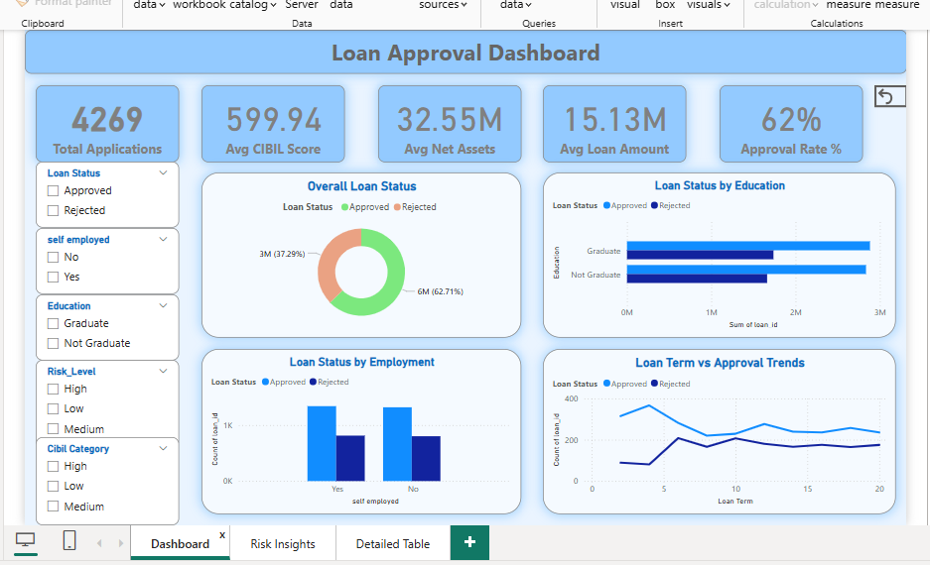

Slide 8
Risk & Approval Insights (Dashboard Page 2)
Focus Areas:
Bar Chart: Risk Level vs Loan Status
Bar Chart: CIBIL Category vs Loan Status
Income Range (Binned) vs Loan Status
Pie Chart: Risk Category Distribution
Additional filters and slicers for deep-dive analysis.

Slide 9
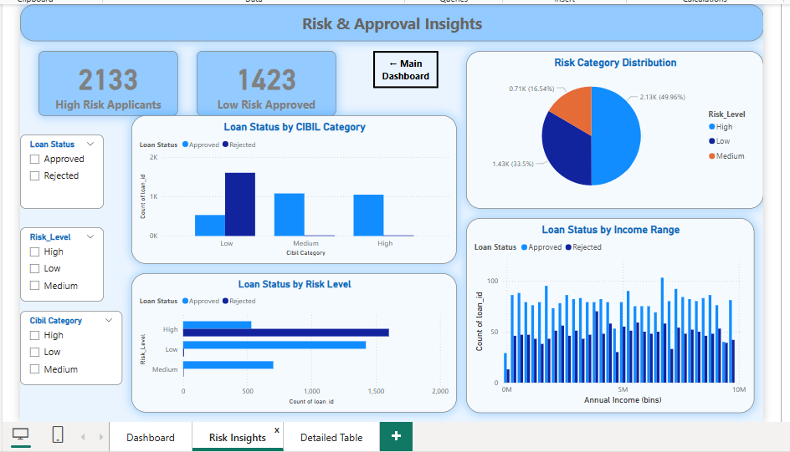

Slide 10
Loan Table (Detailed View - Dashboard Page 3)
Purpose:
Slicer-driven detailed view of each loan application
Filters: Risk Level, Education, CIBIL Category, Loan Status
Reset filters and back navigation buttons.

Slide 11
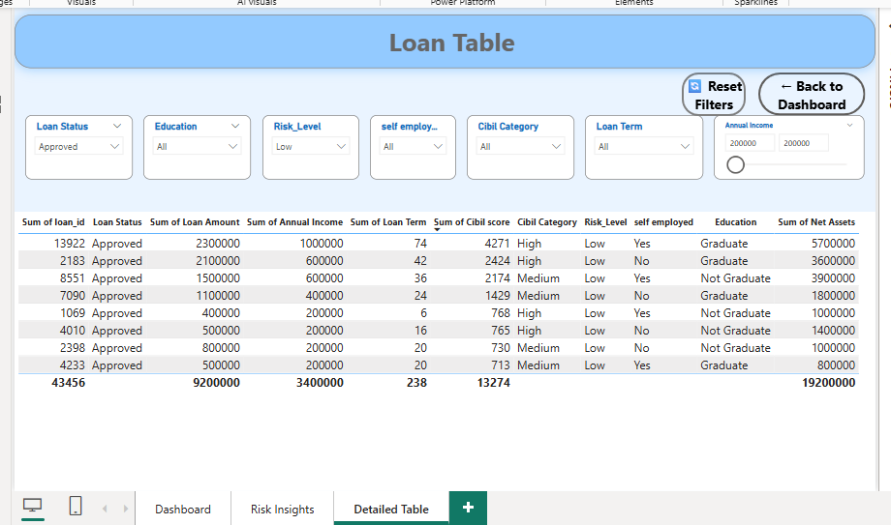

Slide 12
Key Insights
Most approved loans belong to applicants with High CIBIL scores and Low Risk Levels
Self-employed applicants had slightly lower approval rates
Approval rate decreases with longer loan terms
Higher Net Assets correlated with higher approval likelihood

Slide 13
Conclusion
This project made it easier to understand loan approval patterns using visuals. We found useful trends by analyzing income, CIBIL scores, and risk levels. Power BI helped build a dashboard that is both informative and interactive.

Slide 14
Thank You!

